Slide 1


Machine Learning
Clustering Algorithms
Prabaharan S
4th Sep 2024

Slide 2
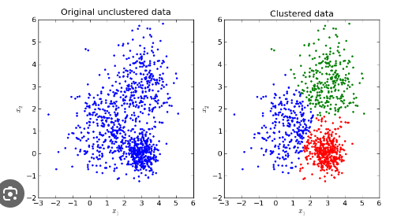
1.K-means Clustering
Definition:
K-means clustering is a partitioning method that divides a dataset into K distinct, non-overlapping subsets (clusters).
The algorithm aims to minimize the variance within each cluster.

Slide 3
Working Principle
Select K initial cluster centroids randomly.
Assign each data point to the nearest centroid, forming K clusters.
Recalculate the centroids of each cluster based on the assigned points.
Repeat the assignment and centroid update steps until convergence (no change in centroids or minimal change)

Slide 4
Advantages and Disadvantages
Advantages:
Simple and easy to implement.
Efficient for large datasets.
Works well with spherical-shaped clusters.
Disadvantages:
Requires specifying the number of clusters (K) in advance.
Sensitive to initial centroid placement.
Not suitable for clusters with varying sizes or densities.

Slide 5
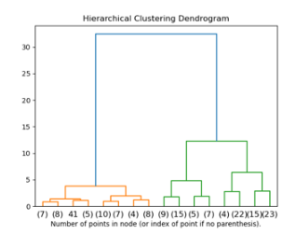
2.Agglomerative Clustering
Definition:
Agglomerative clustering is a type of hierarchical clustering that builds nested
clusters by merging pairs of data points successively.
The process continues until all points belong to a single cluster or a stopping
criterion is met.

Slide 6
Working Principle
Start with each data point as its own cluster.
Merge the closest pair of clusters based on a distance metric
(e.g., Euclidean distance).
Update the distance matrix and repeat until a single cluster remains
or a predefined number of clusters is reached.

Slide 7
Advantages and Disadvantages
Advantages:
Does not require specifying the number of clusters in advance.
Captures a hierarchy of clusters, useful for understanding data structure.
Disadvantages:
Computationally expensive for large datasets.
Sensitive to the choice of distance metric and linkage criterion.
Once a merge is made, it cannot be undone.

Slide 8
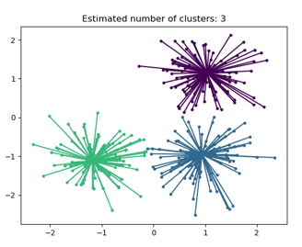
3.Affinity Propagation Clustering
Definition:
Affinity Propagation is a clustering algorithm that identifies exemplars (representative points) by exchanging messages between data points.
It does not require specifying the number of clusters beforehand.

Slide 9
Working Principle
Each data point sends messages to all other points indicating how suitable
they are as exemplars.
Messages are updated iteratively based on "responsibility" and "availability"
measures.
Clusters are formed around points with the highest responsibility-availability
scores.

Slide 10
Advantages and Disadvantages
Advantages:
Automatically determines the number of clusters.
Can find clusters of varying sizes and densities.
Disadvantages:
Computationally expensive for large datasets.
Sensitive to the choice of preference parameter.

Slide 11
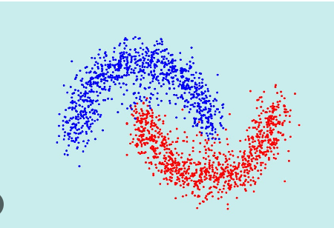
4.Spectral Clustering
Definition:
Spectral Clustering is a graph-based algorithm that uses the eigenvalues of a similarity matrix to reduce dimensionality before clustering.
It is effective for detecting non-convex clusters.

Slide 12
Working Principle
Construct a similarity graph based on the data points.
Compute the Laplacian matrix of the graph.
Perform eigenvalue decomposition and select the top eigenvectors.
Apply K-means clustering on the selected eigenvectors to form clusters.

Slide 13
Advantages and Disadvantages
Advantages:
Suitable for non-convex clusters.
Can handle complex data distributions.
Disadvantages:
Computationally expensive for large datasets.
Requires a similarity matrix, which can be difficult to define.

Slide 14
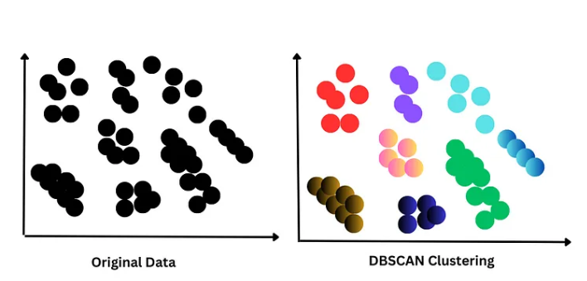
5.DBSCAN Clustering
Definition:
DBSCAN (Density-Based Spatial Clustering of Applications with Noise) is a density-based algorithm that clusters points based on the density of their neighborhood.
It can identify arbitrarily shaped clusters and outliers.

Slide 15
Working Principle
Define core points with at least min_samples neighbors within eps distance.
Expand clusters from core points by adding
density-reachable points.
Mark points not reachable by any core point as noise.

Slide 16
Advantages and Disadvantages
Advantages:
Does not require specifying the number of clusters.
Can find arbitrarily shaped clusters and detect outliers.
Disadvantages:
Sensitive to parameter settings (eps and min_samples).
Not suitable for datasets with varying densities.

Slide 17
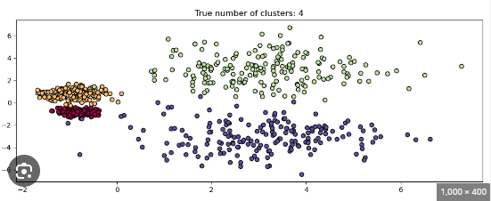
6.HDBSCAN Clustering
Definition:
HDBSCAN (Hierarchical DBSCAN) extends DBSCAN by converting it into a hierarchical clustering algorithm.
It allows for varying cluster densities and provides a hierarchy of clusters.

Slide 18
Working Principle
Construct a minimum spanning tree of the distance-weighted data points.
Generate a hierarchy of clusters by varying the density threshold.
Extract clusters using a stability measure to find the most persistent clusters.

Slide 19
Advantages and Disadvantages
Advantages:
No need to specify the number of clusters.
Handles varying cluster densities and noise.
Disadvantages:
Computationally more expensive than DBSCAN.
Parameter tuning can be complex.

Slide 20
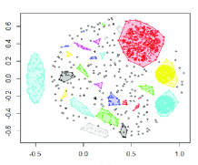
7.OPTICS Clustering
Definition:
OPTICS (Ordering Points To Identify the Clustering Structure) is a density-based clustering algorithm that extends DBSCAN to handle varying densities.
It produces an ordering of the points that reflects their density-based clustering structure.

Slide 21
Working Principle
The algorithm orders data points based on their density reachability distance.
A reachability plot is generated, and clusters are identified by valleys in the plot.
Points with similar densities form clusters, while points with no neighbors are
considered noise.

Slide 22
Advantages and Disadvantages
Advantages:
Handles clusters of varying densities well.
Does not require specifying the number of clusters.
Can identify nested clusters and noise points.
Disadvantages:
Computationally expensive compared to DBSCAN.
Interpreting reachability plots can be complex.

Slide 23
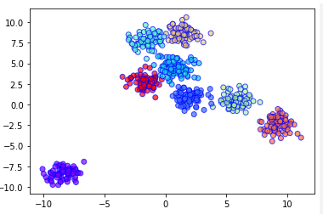
8.BIRCH Clustering
Definition:
BIRCH (Balanced Iterative Reducing and Clustering using Hierarchies) is a hierarchical clustering algorithm designed for large datasets.
It builds a Clustering Feature tree structure (CF tree) to summarize the data, and clusters are formed by traversing this structure.

Slide 24
Working Principle
Build a CF tree, where each node represents a cluster of data points
summarized by their centroid.
Points are inserted into the tree, and sub-clusters are formed dynamically.
Clusters are refined during the global clustering phase, using methods
like K-means or agglomerative clustering.

Slide 25
Advantages and Disadvantages
Advantages:
Scalable to large datasets.
Can incrementally process new data points.
Handles noise and outliers effectively.
Disadvantages:
Performance can degrade with high-dimensional data.
The structure of the CF tree depends heavily on the input order of data.

Slide 26
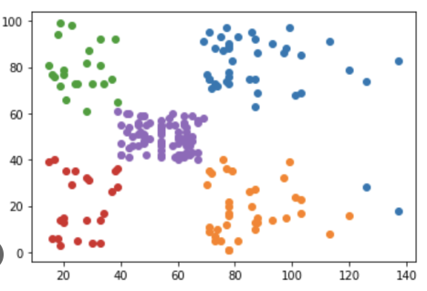
9.BisectingKMeans Clustering
Definition:
Bisecting K-means is a hierarchical clustering algorithm that repeatedly splits clusters using K-means.
It combines elements of both divisive hierarchical clustering and K-means partitioning.

Slide 27
Working Principle
Start with all data points in a single cluster.
At each iteration, the current cluster is bisected using K-means to form
two sub-clusters.
The bisection that minimizes intra-cluster variance is chosen, and this
process continues until the desired number of clusters is reached.

Slide 28
Advantages and Disadvantages
Advantages:
Often more efficient and scalable than standard K-means.
Allows control over the number of splits and clusters.
Disadvantages:
Sensitive to initial cluster centroids.
May result in suboptimal splits if poor bisections are made early.

Slide 29
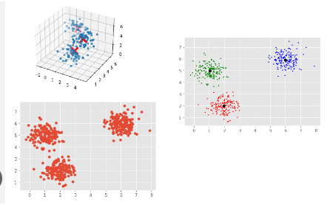
10.MeanShift Clustering
Definition:
MeanShift is a non-parametric, density-based clustering algorithm that does not require specifying the number of clusters.
It works by shifting points towards areas of higher data density (modes of the density function).

Slide 30
Working Principle
Place a window over each data point and compute the mean of points
within the window.
Shift the window to the mean and repeat this process until convergence.
Points that converge to the same mode are assigned to the same cluster.

Slide 31
Advantages and Disadvantages
Advantages:
Does not require pre-specifying the number of clusters.
Can detect clusters of arbitrary shapes and sizes.
Disadvantages:
Computationally expensive, especially for large datasets.
Requires selecting a suitable bandwidth parameter for the window, which
can be challenging.

